Slide 1


Strategic Communication
For Lasting Impact
Connecting MDC’s Message with Youth, Parents, and Individuals in Recovery
BRIAN BROOKS

Slide 2
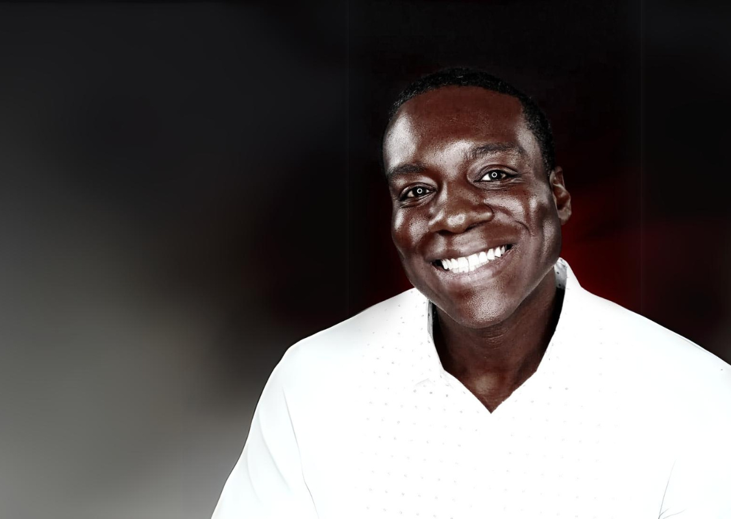
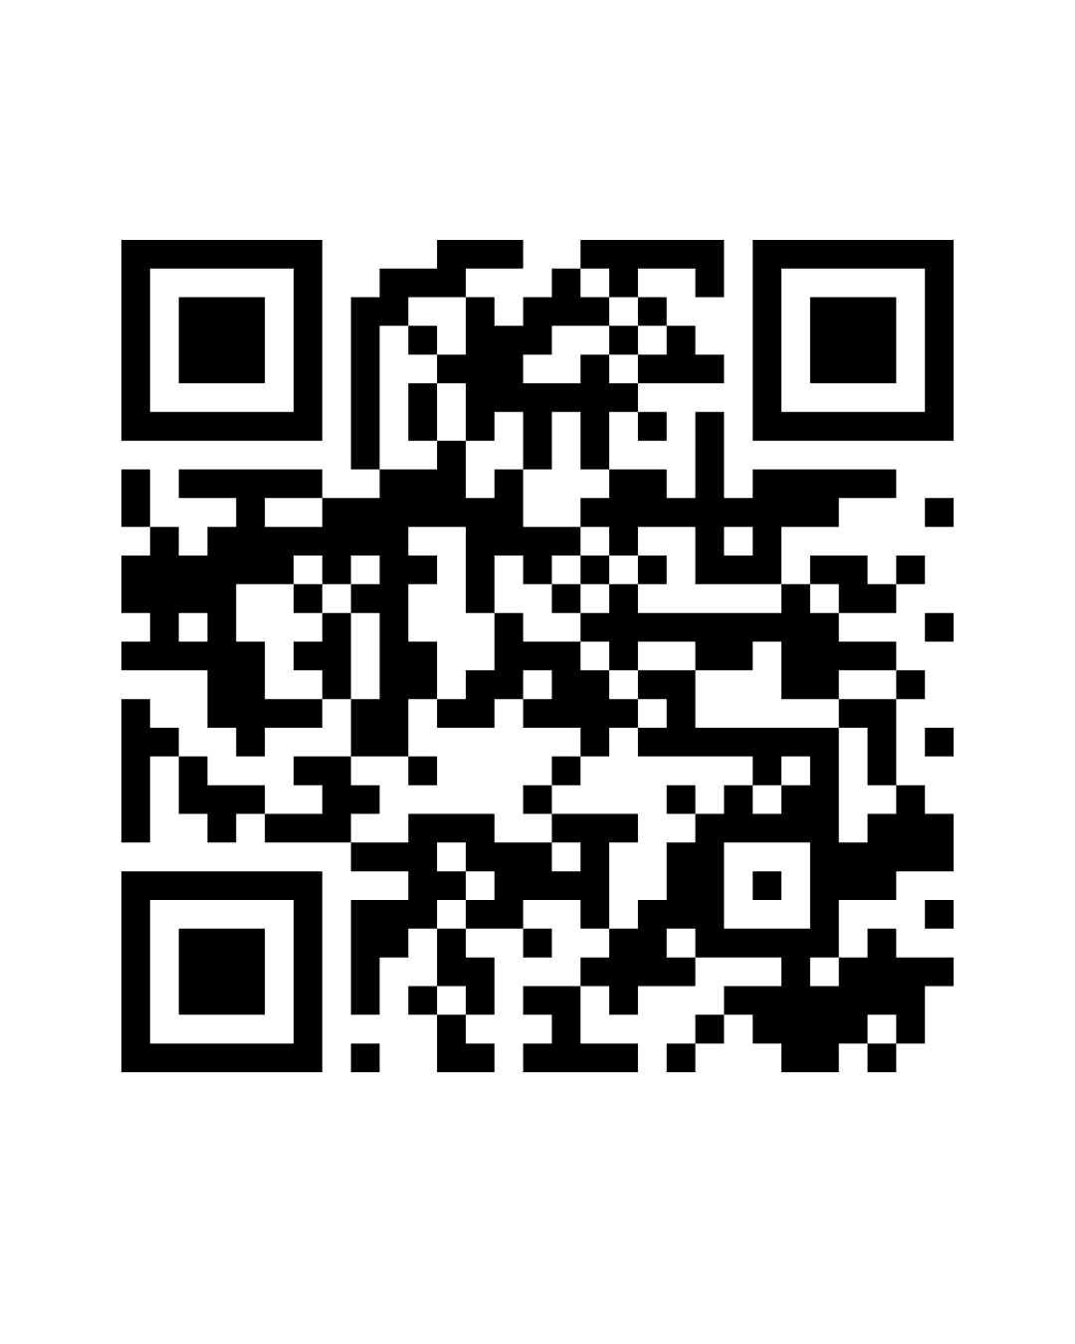
Brian
Brooks
Community Organizer
Marketing Consultant
Media Creative
Portfolio

Slide 3
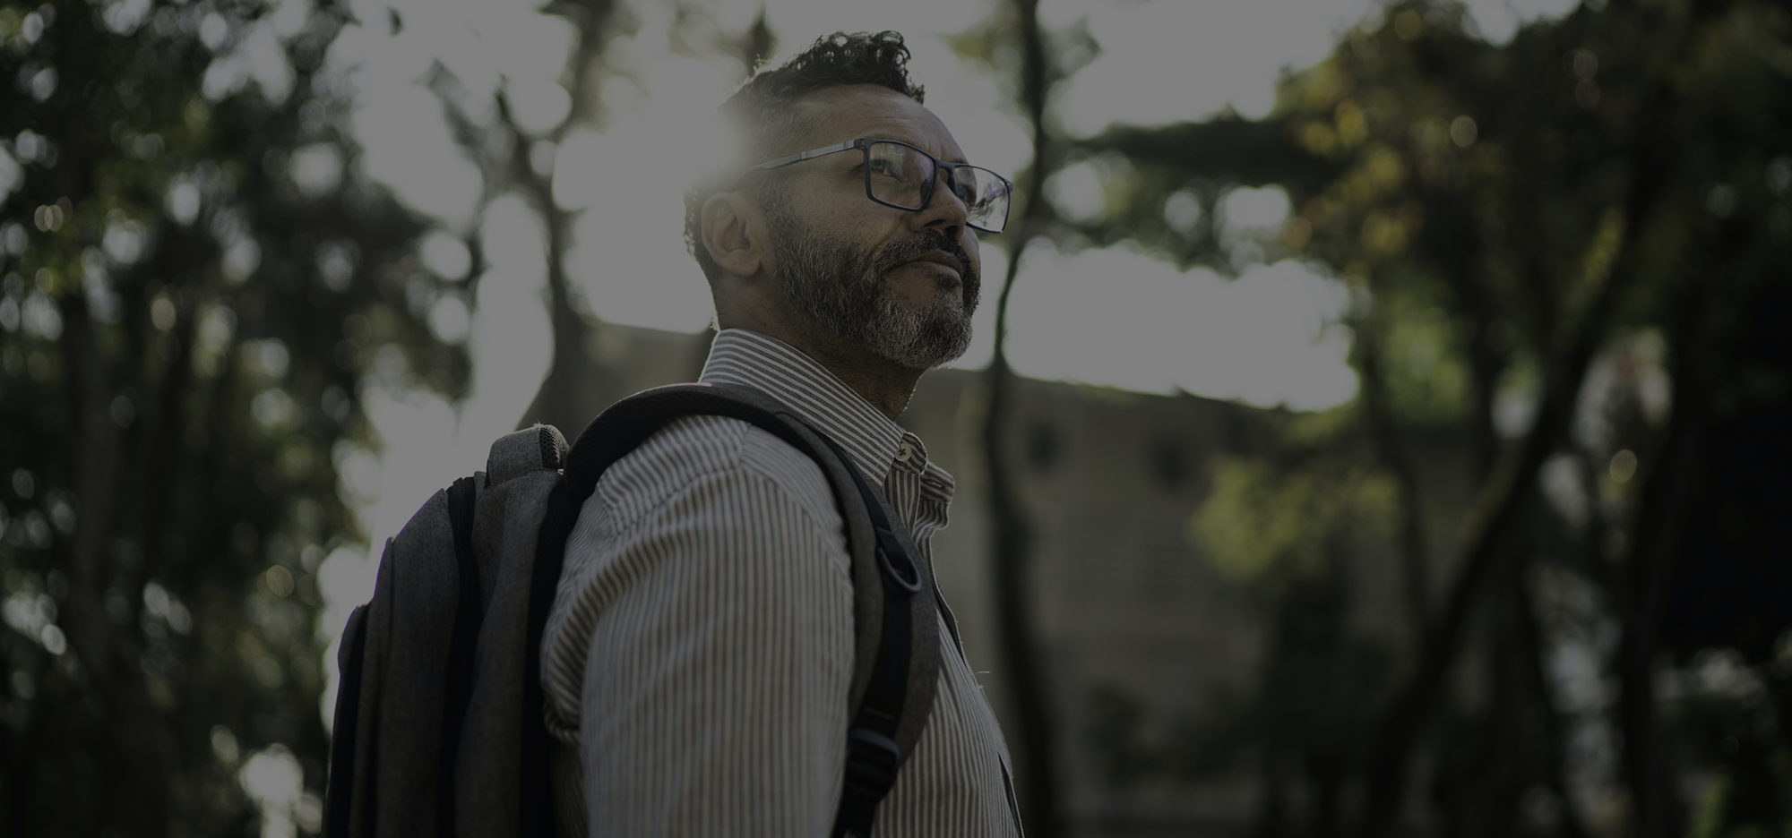
MDC Vision
“A healthy and safe community, free of substance misuse.”

Slide 4
Audience Overview
YOUTH | PARENT | ACTIVE RECOVERY
Jayden Carter | Jessica Miller | Anthony ‘Tony’ Jacobs
Gender: Male | Gender: Female | Gender: Male
Age: 17 | Age: 38 | Age: 34
Race/Ethnicity: African American | Race/Ethnicity: White | Race/Ethnicity: White
Household Income: 40K-50K | Household Income: 90K | Household Income: 32K
Location: East Knoxville | Location: Northwest Knoxville | Location: North Broadway

Slide 5
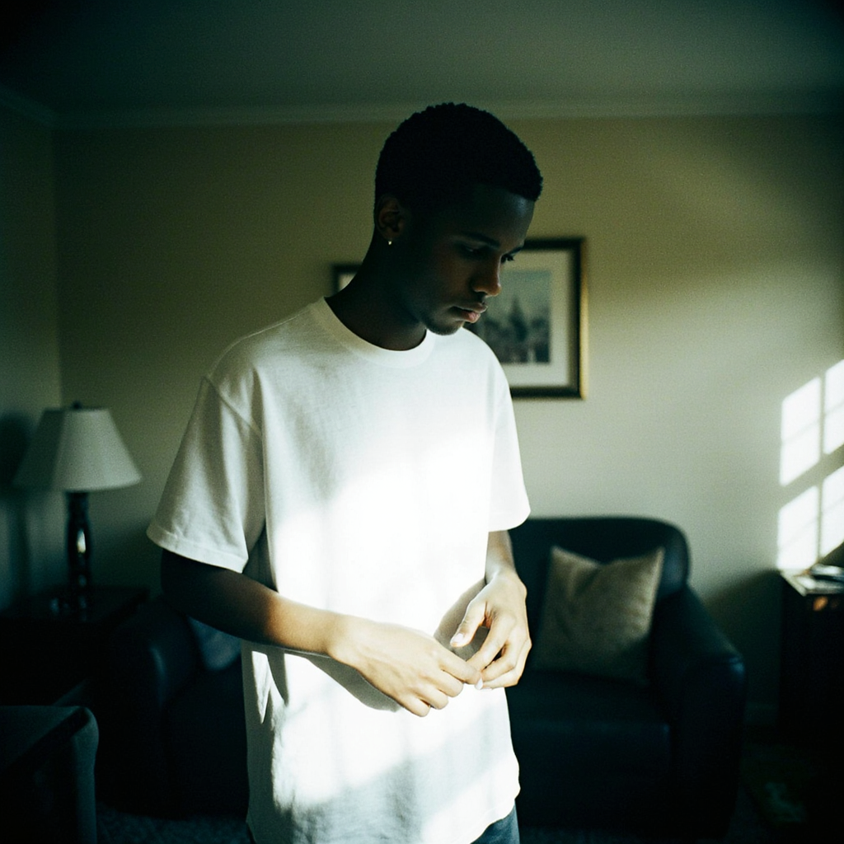
YOUTH
Jayden Carter
Gender: Male
Age: 17
Race/Ethnicity: African American
Household Income: 40K-50K
Location: East Knoxville (Carter)

Slide 6
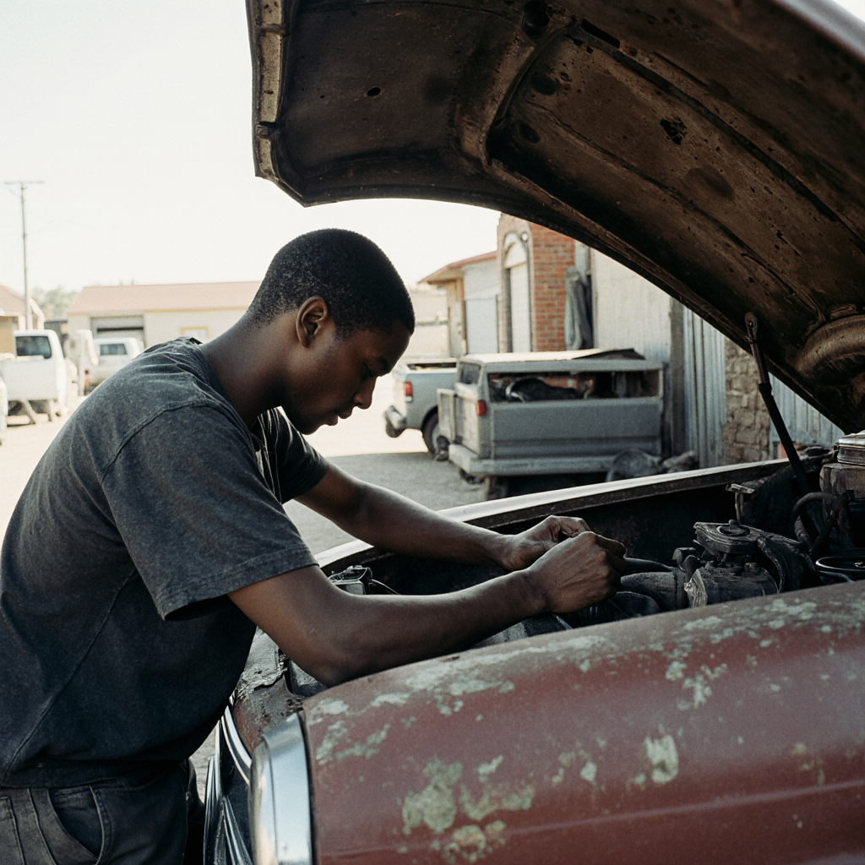
Youth
Unique Approach:
Empower and educate through storytelling and peer-led engagement.
Highlight real youth voices and achievements (short videos or mini-campaigns).
Utilize Artificial Intelligence Characters
Channels:
Instagram, TikTok, Snapchat, YouTube Shorts, and school partnerships.
Collaborations with student influencers, local athletes, or creatives.

Slide 7
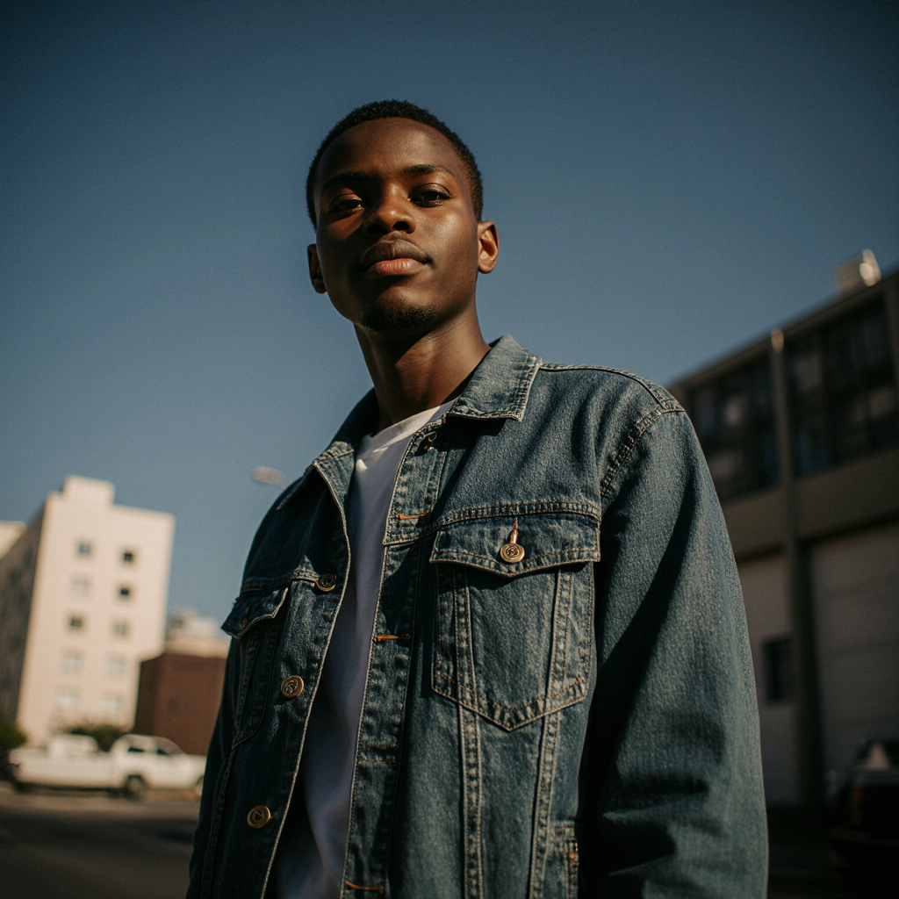
Youth
Content & Cadence:
2–3 short-form posts weekly using trends and challenges tied to MDC’s message.
Quick facts in digestible formats (carousel posts, short videos)
Monthly “Youth Spotlight” stories showing transformation, hope, and leadership.
Ideas:
Who is your Next? A sharable behind-the-scenes look at YMDC
Wrong Answers Only Campaign (How to hide drugs from parents. “Wrong answers only”)
Hire an “AI” Dealer to Work for MDC (Here's every trick I used… & here's how to spot it.)
"The Fentanyl Challenge" (Reverse Psychology Campaign on how dealers manipulate them)

Slide 8
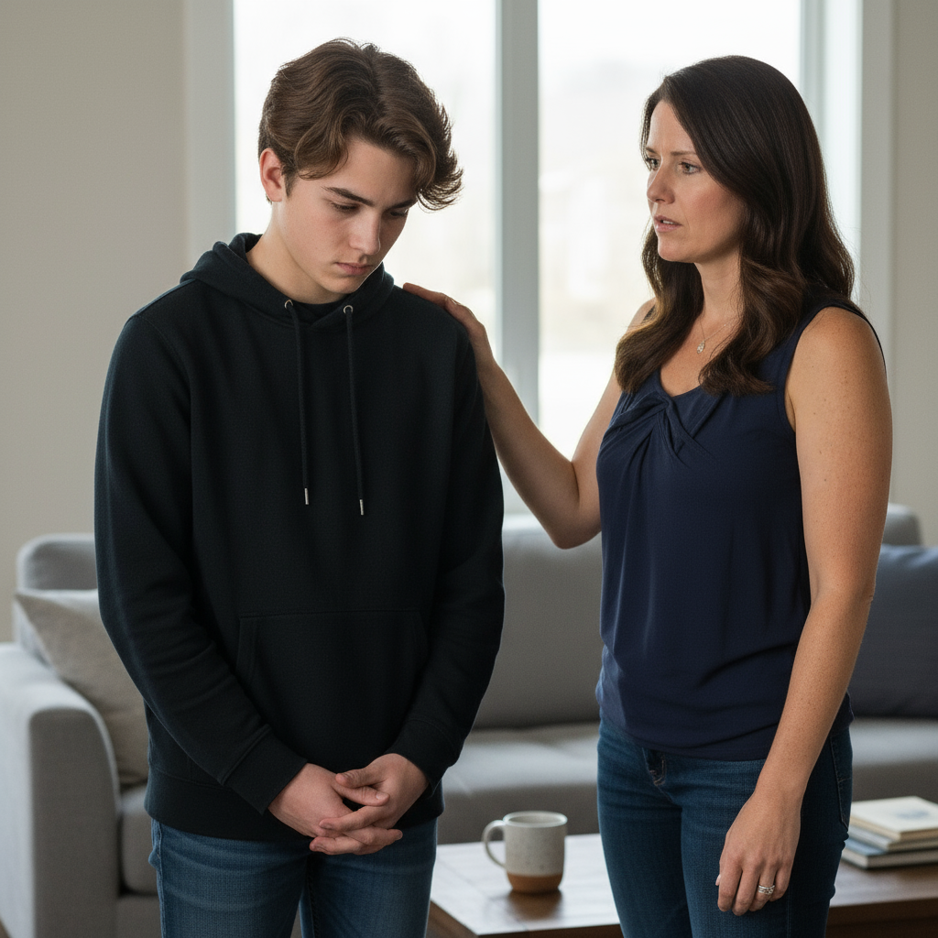
Parent
Jessica Miller
Gender: Female Age: 38 Race/Ethnicity: White
Household Income: 40K-50K
Location: Northwest Knoxville

Slide 9
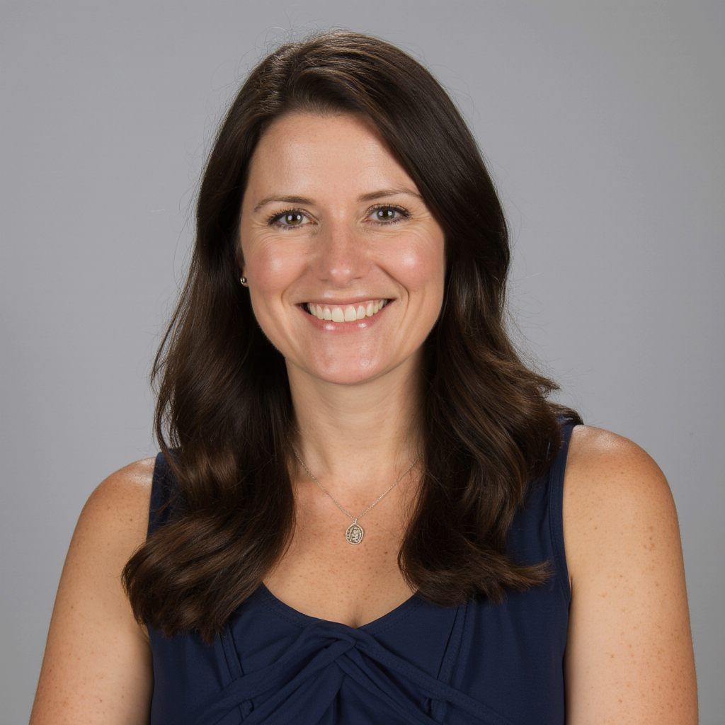
Parent
Unique Approach:
Position MDC as a trusted parenting resource, not just crisis intervention
Acknowledge parents' fears while empowering them with practical tools
Create safe spaces for parents to ask "embarrassing" questions
Channels:
Email newsletter (parents check email regularly), Facebook
School/PTA partnerships, community events
Local media partnerships (WBIR, WATE for expert segments)

Slide 10
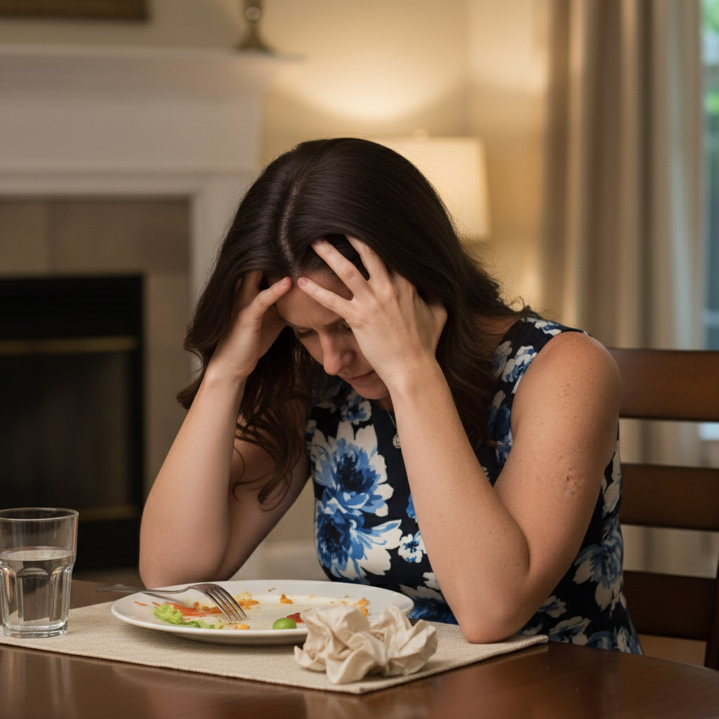
Parent
Content & Cadence:
Monthly newsletters with local success stories, safety tips, and resources.
Weekly posts on Facebook highlighting prevention tools, parenting workshops, or student milestones.
Ideas:
"Conversation starters" for talking to kids about substances
Local data and trends (parents want to know what's happening in Knox County)
"Parent War Room" Monthly Meetups (Share intel: "Here's what I found”)
"The Dealer's Playbook" Email Series (show tactics: Snapchat dealing, Venmo code words)

Slide 11
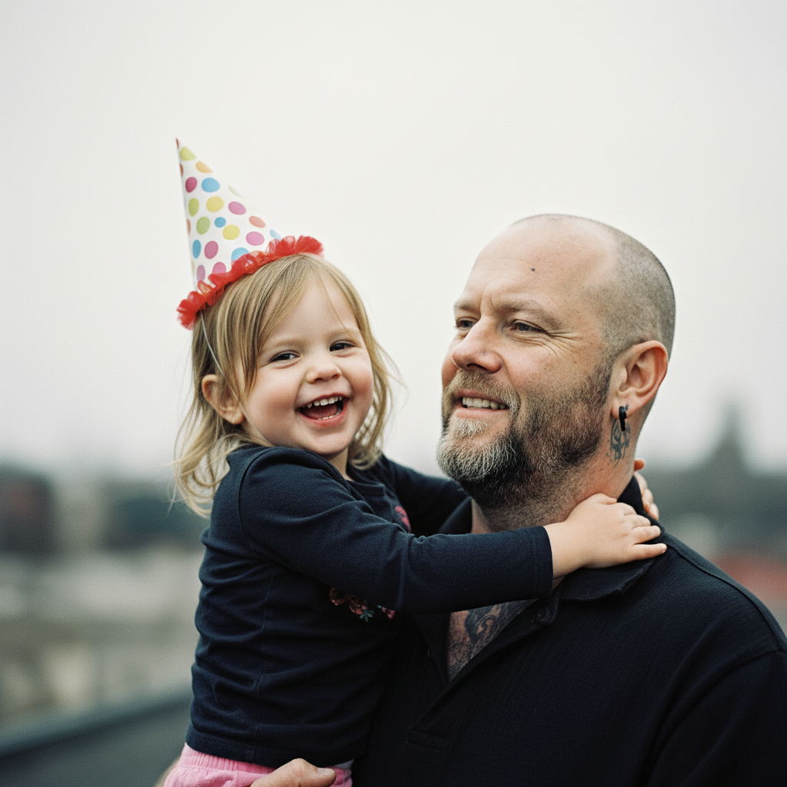
Active Recovery
Anthony ‘Tony’ Jacobs
Gender: Male Age: 34 Race/Ethnicity: White
Household Income: 32K
Location: North Broadway

Slide 12
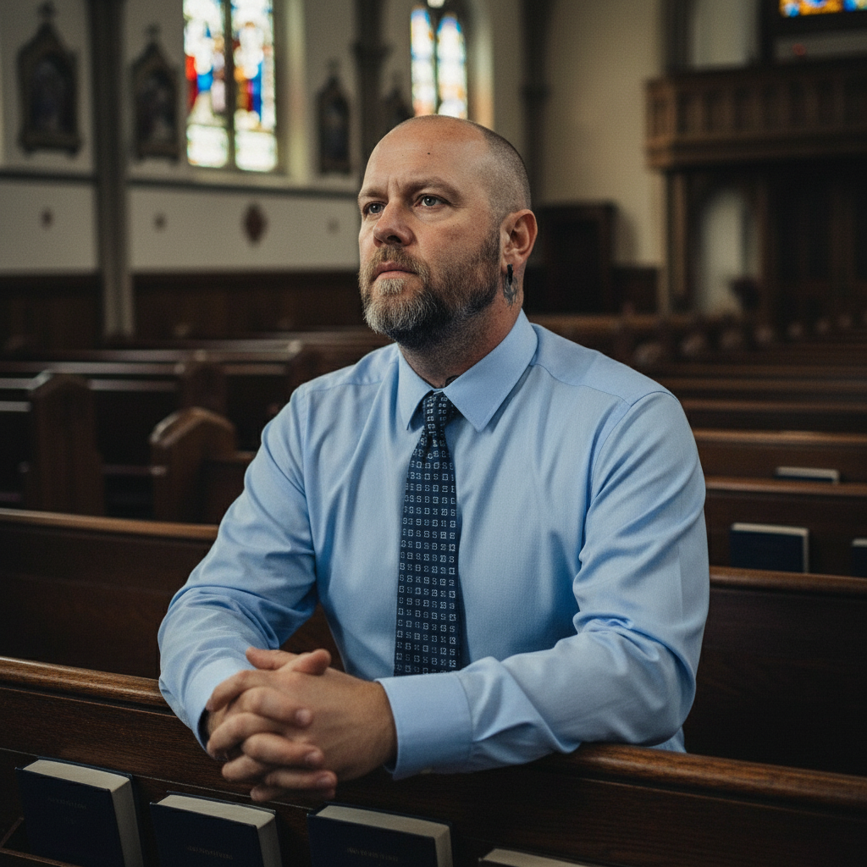
Active Recovery
Unique Approach:
Community-first messaging: Recovery is a journey best traveled together
Encourage belonging through authentic storytelling and encouragement.
Use peer mentors or alumni voices to make hope visible.
Channels:
The Gateway itself (physical space as communication hub), text/SMS reminders
Facebook groups (private community spaces) or WhatsApp groups, podcasts,
Direct mail for event invitations, recovery housing partnerships

Slide 13
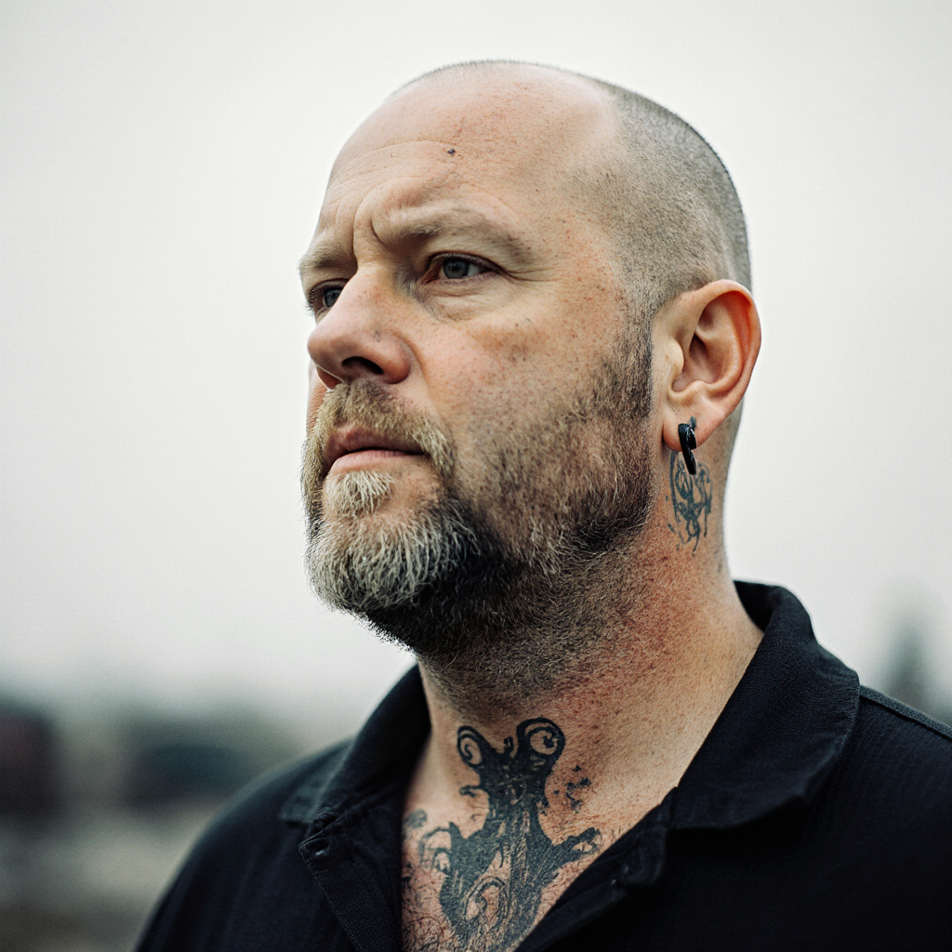
Active Recovery
Content & Cadence:
Weekly encouragement messages or video stories of recovery.
Monthly podcast episodes or spotlights featuring lived experiences.
Gentle, consistent contact rather than overwhelming frequency.
Ideas:
Gateway class schedules and event photos (showing vibrant community)
Peer testimonials about specific programs (yoga, music therapy, coffee shop)
"Meet the Team" profiles humanizing staff
"Recovery Receipts" Campaign (participants share "receipts" of recovery, first paycheck)
The Gateway After Dark: Friday/Saturday 9pm-1am (Meets people during crisis hours)

Slide 14
Questions?
Answers.

Slide 15
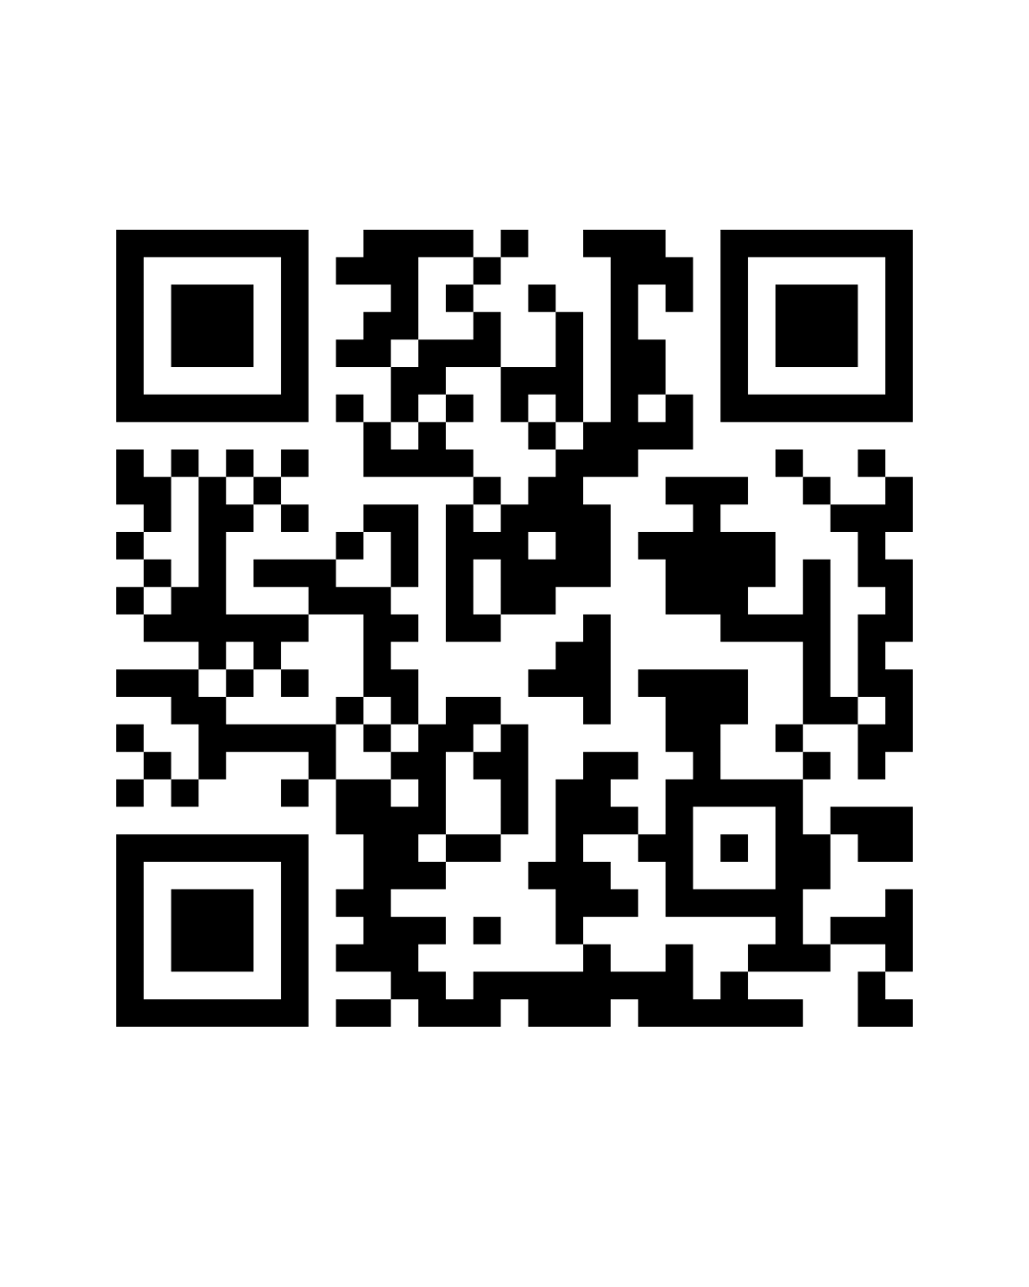
Thank You for Listening Scan the QR code to download my presentation.

Slide 16
Brian Brooks 865-816-9864
brian@eternalmg.com

